Slide 1
Barnardo’s WESAIL
This resource has been created by Barnardo’s whilst they held the WESAIL contract 2018-2022
Notes:
Explain that today’s assembly/presentation is about the Barnardo’s WESAIL service.
The rest of the slides explain everything else, so there is no need to expand on this here.

Slide 2
Inclusion!
What is it?
H_lp _ _g
_v _ ry_ n_
t_
j_ _n
_ n
Helping
everyone
to
join
in
This resource has been created by Barnardo’s whilst they held the WESAIL contract 2018-2022
Notes:
Explain that one of the really important things that WESAIL helps people with is “inclusion”.
Click on the slide to bring up the “missing letters” definition (part 1) of inclusion.
Ask children and young people to guess what each word is, one by one. The words are revealed (one by one) by clicking on the slide.
The definition is: helping everyone to join in.

Slide 3
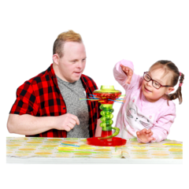
Inclusion!
What is it?
B_in_
f_ _r
_nd
k_n_
Being
fair
and
kind
This resource has been created by Barnardo’s whilst they held the WESAIL contract 2018-2022
Notes:
Explain that there is another part to what “inclusion” is.
Click on the slide to bring up the “missing letters” definition (part 2) of inclusion.
Ask children and young people to guess what each word is, one by one. The words are revealed (one by one) by clicking on the slide.
The definition is: being fair and kind.
Stress to children and young people that we are all different and that is what makes us brilliant and interesting. We should be proud of what makes us who we are!

Slide 4
What do WESAIL do?
You might also hear WEASAIL being called SENDIASS.
SEND IASS
pecial
ducational
eeds
isability
nformation
dvice
upport
ervice
This resource has been created by Barnardo’s whilst they held the WESAIL contract 2018-2022
Notes:
Explain that sometimes some of the things that make us who we are might mean that we need a bit of extra help to take part in things. WESAIL can help some people with this.
Tell children and young people that they might hear WESAIL being called SENDIASS. People mean the same thing.
Explain that the letters that spell SENDIASS stand for words that explain more about the service.
Click on the slide until the red letters spelling SENDIASS appear, then the accompanying pictures, but nothing else.
Explain that SEND is the first part of the word – ask children and young people if they have any ideas about what the letters might stand for. Tell them that the pictures on the slide might help. Encourage them to share their answers. Click to reveal the answers for the letters SEND only.
Tell children and young people that these words explain who WESAIL/SENDIASS help. The IASS part explains a bit about what they do.
Ask children and young people if they have any ideas about what the letters IASS might stand for. Tell them that the pictures on the slide might help. Encourage them to share their answers. Click to reveal the answers

Slide 5
What is SEND?
Special Educational Needs
Disability
Needing extra help with learning.
Physical or mental condition that makes it difficult to do things. e.g. walk, speak, hear, see or learn.
How many children in schools in the UK have SEND?
1.3 million
This resource has been created by Barnardo’s whilst they held the WESAIL contract 2018-2022
Notes:
Explain more about SEND as follows:
SEN – extra help could include working in smaller groups to learn things, having an assistant in class, etc.
Disability – this can be disabilities that people are born with, or things that develop as a result of an illness or injury.
Ask children and young people to guess the number of children in schools in the UK who have SEND (the number is from the Department for Education, January 2019).
Reveal the answer. Explain that 1.3 million is about 15% of children in UK schools. That is around 5 children in every class of 30.

Slide 6
What about the IASS bit?
This resource has been created by Barnardo’s whilst they held the WESAIL contract 2018-2022
Notes:
Explain that SEN and Disability can (sometimes) affect people’s ability to learn and might mean that they need extra help.
Knowing what help is there, and how to get it, is where WESAIL/SENDIASS comes in! That’s the IAS (information, advice and support) part.
Show the video clip (from the Council for Disabled Children) that explains about IAS services. It is a YouTube hyperlink so you will need internet access. Stop the video at 1 minute 36 seconds.

Slide 7
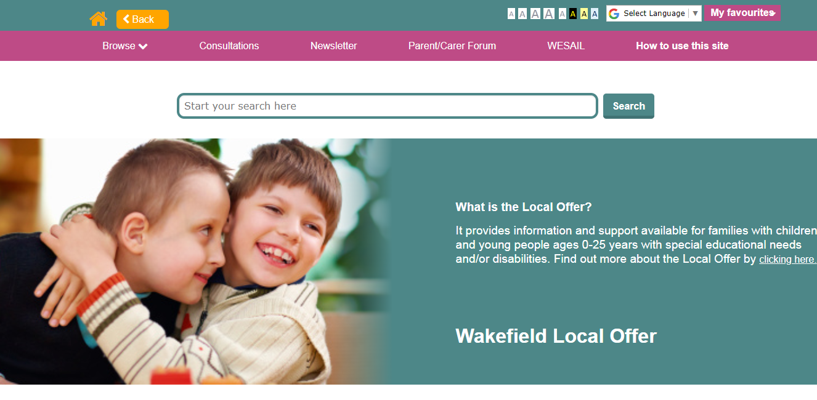
What can SENDIASS help with?
School or college
Health
Social care
And there’s the Local Offer website too….
This resource has been created by Barnardo’s whilst they held the WESAIL contract 2018-2022
Notes:
Use this slide to recap and expand on the points that were raised on the video, as follows:
School and college – children and young people with SEND might need extra support in school to learn things or they might need help to plan things like what to do when they have finished school e.g. college, jobs, apprenticeships.
Health – children and young people might want to understand more about their SEND or they might need help to get specialist equipment.
Social care - children and young people with SEND might want to know who else can help them. Social care workers might help children and young people at home or give them breaks away from their families.
Explain that as well as helping people with the above, WESAIL/SENDIASS are also responsible for the Local Offer website, which has lots of information and advice on it for Children and Young People with SEND and their families in Wakefield. This includes information on things to do e.g. activities, clubs and groups.

Slide 8
Get in touch!
07961 897036
wesail@barnardos.org.uk
https://www.facebook.com/WESAILWakefield/
https://barnardossendiass.org.uk/wakefield-sendiass/
http://wakefield.mylocaloffer.org/
This resource has been created by Barnardo’s whilst they held the WESAIL contract 2018-2022
Notes:
Go through the different ways in which children and young people can contact WESAIL/SENDIASS.
Explain that they can have an information sheet about SENDIASS that has all of these links on it. Tell children and young people how they can get a copy of this in your school or college. There is a link to the sheet, and a hard copy, in the Resource Pack. Or you can follow this link: https://barnardossendiass.org.uk/media/sfyfgqka/what-is-sendiass-info-sheet-for-young-people.pdf

